Slide 1
HTTP-REPL
Pandiyan Murugan
08-Nov-18
Tech Talk

Slide 2
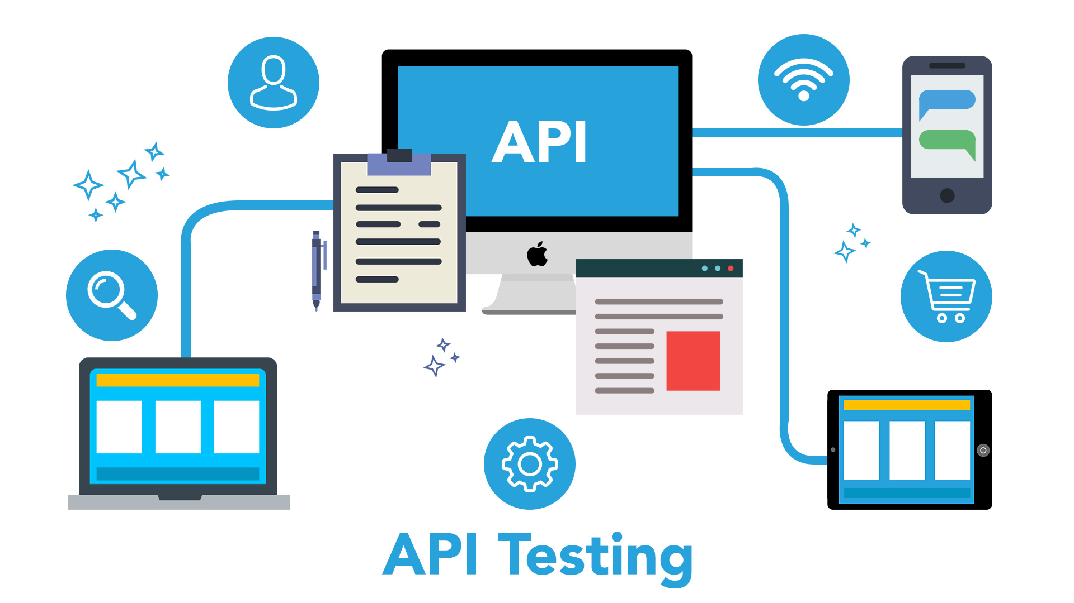
API Testing

Slide 3






Slide 4


Slide 5
Web API Improvements in ASP.NET Core 2.2
Easier to create
Easier to test & debug
Easier to document
Easier to consume
Easier to secure
Easier to monitor
Improved performance

Slide 6
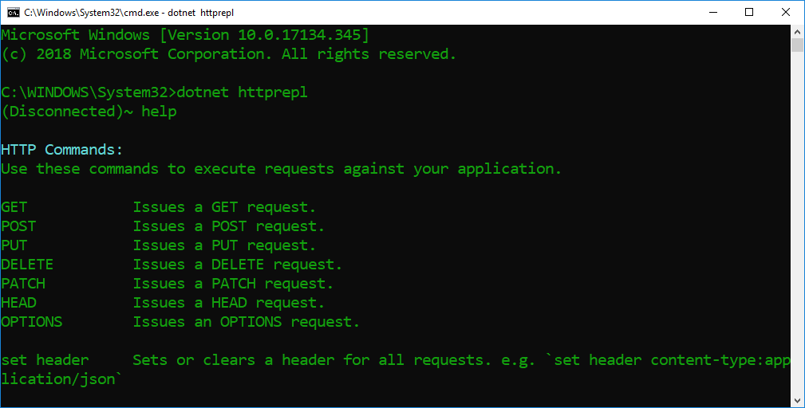
HTTP-REPL

Slide 7
Preview release
dotnet tool install -g dotnet-httprepl –version 2.2.0-* –add-source https://dotnet.myget.org/F/dotnet-core/api/v3/index.json

Slide 8


Thanks, Keep supporting ☺
Subscribe to Efficient User
and click the bell icon.
Developer blogs
efficientuser.com
nullablereference.wordpress.com

